Slide 1
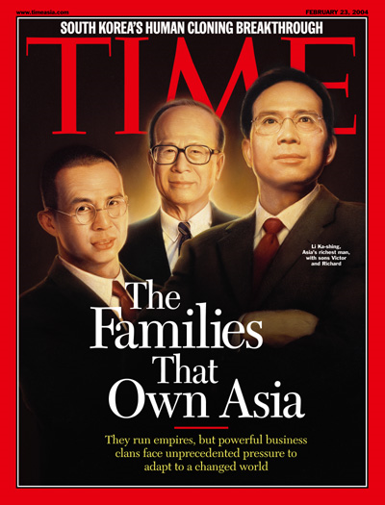
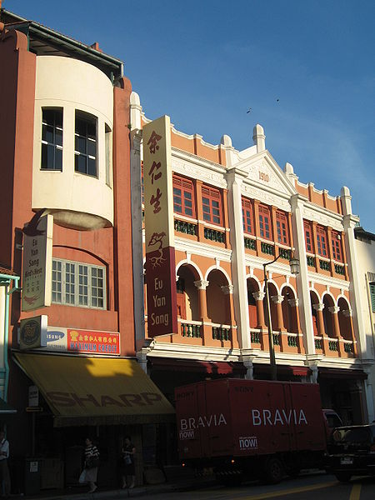

NATIONAL UNIVERSITY OF SINGAPORE DEPARTMENT OF HISTORY FAMILY capitalism
A/P Medha Kudaisya

Slide 2
FAMILY CAPITALISM OUTLINE
Characteristics of ‘Family’ Business in Asia
Defining Family Business
Literature on Family & Firm
Wong Siu-lun, Henry Yeung
Case study:
Eu Yan Sang, Singapore
Challenges to contemporary family firms

Slide 3
CHARACTERISTICS OF ASIAN FAMILY BUSINESSES (I): DEFINING FAMILY BUSINESS
Defining ‘Family’
Ownership
Effective Control
Share Value/ Capital ownership
Inter-generational Succession
‘Set of beliefs and values that lie behind business behavior’ (Gordon Redding, The Spirit of Chinese Capitalism (NY, 1993)

Slide 4
CHARACTERISTICS OF ASIAN FAMILY BUSINESSES (II)
INTERNAL STRUCTURE OF FIRM
Patrimonialism
Overlap of ownership, control and power
Style of leadership
Personalistic Relations
Relations are personal, not neutral

Slide 5
CHARACTERISTICS OF ASIAN FAMILY BUSINESSES (III)
INTER- FIRM RELATIONSHIPS
Trust & personal relationships
Kinship, ‘native-place’, locality, region
Unique strategies of dispute resolution

Slide 6
CHARACTERISTICS OF ASIAN FAMILY BUSINESSES IV (contd.)
Advantages
Co-operation within and across organization
Strategic adaptability
Low information costs
‘Entrepreneurial familism’

Slide 7
CHARACTERISTICS OF ASIAN FAMILY BUSINESSES (V)
Disadvantages
Management issues
Limited delegation of authority
Networks dependence
Expansion limitations
Limited capital sources
Practices of inheritance

Slide 8
Models of Growth
Familism a ‘brake’ on Asian business
Most Asian businesses small & do not survive beyond 3 generations
Family conflicts inevitable
Large businesses concentrated in 1 sector or operating in “soft” environments
Dependent on official patronage and cronyism

Slide 9
Models of Growth (I)
Wong Siu-lun’s 4-stage model
Emphasis on family members
Stage 1
Emergent
Partners
Stage 2
Centralised
Patriarch
Stage 3
Segmented
Brothers
Stage 4
Disintegrative
Cousins

Slide 10
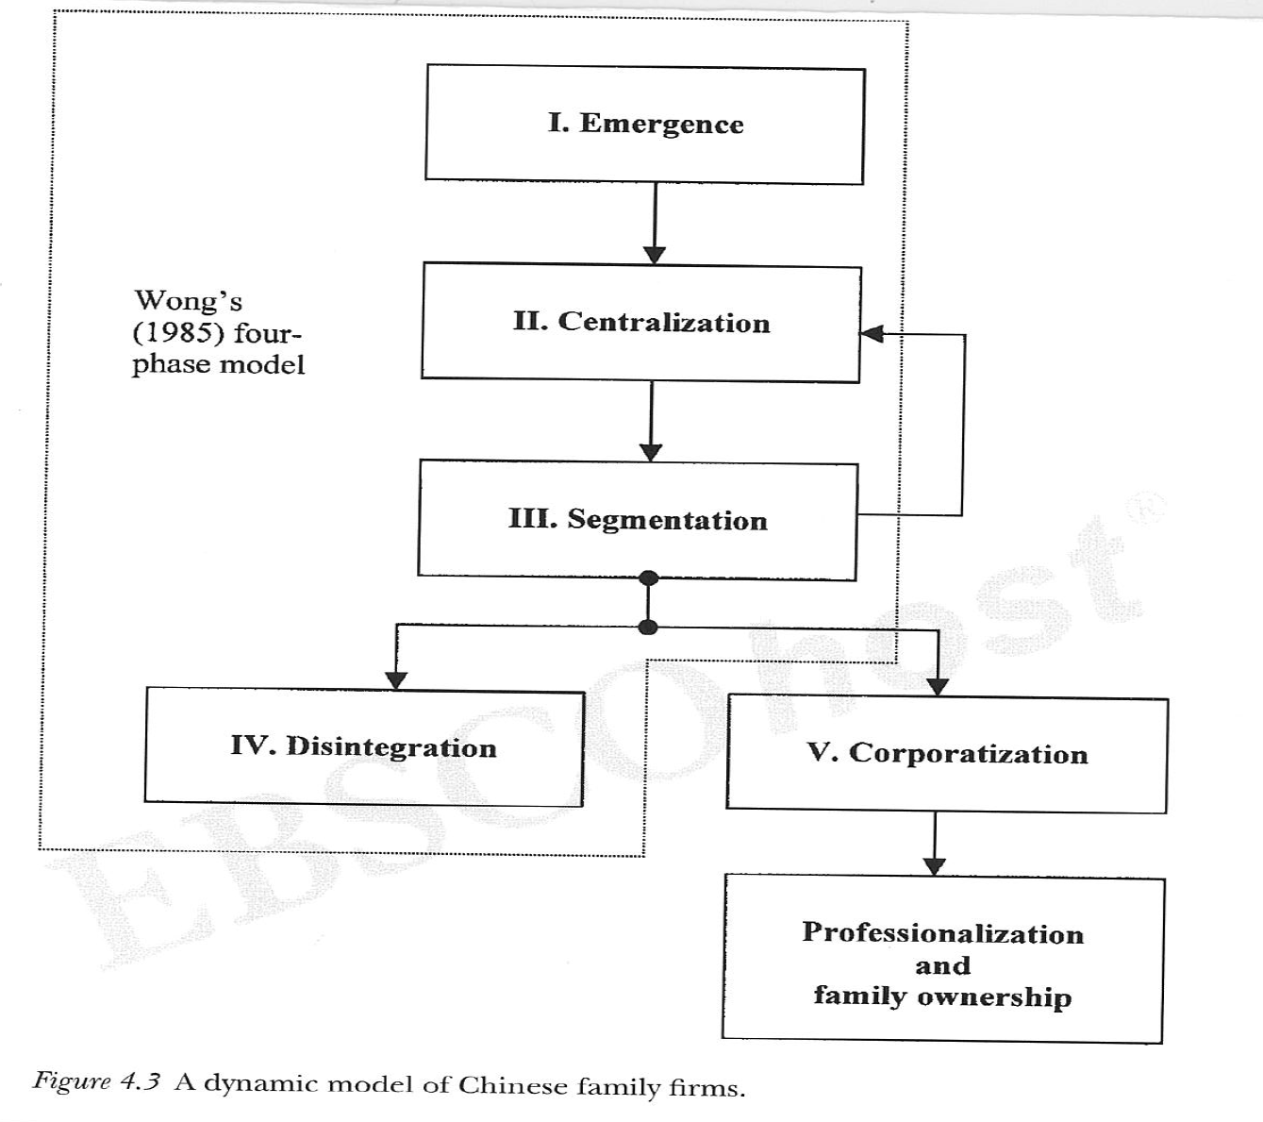
Models of Growth (II)
Henry Yeung W. C, Chinese capitalism in a global era : towards hybrid capitalism chapter 4, pp. 154.

Slide 11
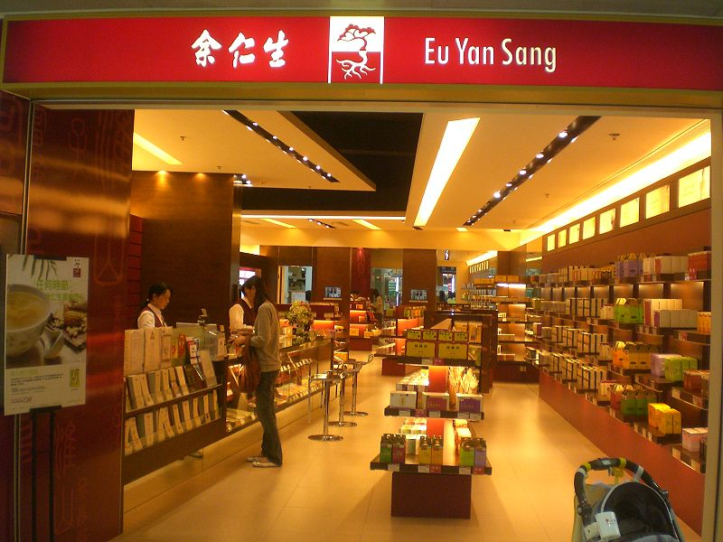
Case Study: Eu Yan Sang Medical Shop, 1879 -
1879 onwards:
Informal herbal medicine business transformed into a modern enterprise
Internationalized business
Consolidated corporate structures
Professionalized management
Transnational operations
Role of Family (fourth generation & beyond)

Slide 12
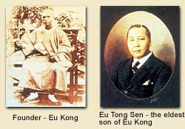
Eu Yan Sang
1879, established by Eu Kong
Eu family of Foshan (Fushan) origin
Penang 1876
1877 Fabric business
Bakery
Retail shop
1890: Eu Tong Sen succeeded business
2nd generation
Wong’s Model: Phase I ‘Emergence’

Slide 13
Case Study: Eu Yan Sang Medical Shop, (Eu Tong Sen)
Eu Tong Sen (2nd generation)
Diversifications
Tin mining: Invested in mechanization
Tax farming, Perak in the 1880s
Retailing & collecting taxes on Chinese goods sold to the miners
- Sold Chinese medicine: Yan Sang shop
Abolition of the tax farming system (1890s)
Rubber plantations (2 estates)
Banking and Remittance business (one of the 2 richest business persons in Malaya)
Remittance between the Malaya Peninsula and Hong Kong

Slide 14
Case Study: Eu Tong Sen: (2nd generation)
Political Assets
1903: Purchased an official title from the Qing Govt
Philanthropic Acts (anti-opium smoking campaign)
1915 Donation to HK University
1911- 1920 Member of the Federal Council of Malaya
Renamed the shop Yan Sang – to Eu Yan Sang (builds up social image of family)
Serves tin miners
Entered the Remittance Business

Slide 15
Phase II of Business Model
Diversification
1900s: KL, Seramban, Ipoh
1909: overseas: Hong Kong
1910: Singapore
1920s: China
Sole Proprietorship
Change in name: Eu Yan Sang Medical Shop
Successes of 1910s and 1920s

Slide 16

Case Study: Third Generation takes over
Eu Tong Sen: retired (Hong Kong)
Third Generation (Eu Tong Sen had 13 sons)
Keng Chee Eu (K C Eu) appointed successor (Chartered accountant)
Diversifications in 1920s
Modern Banking: 1920, Lee Wah Bank in Malaya (S$10,000)
Real estate : Hong Kong, Malaya and Singapore
340 pieces of property by 1941
Medicine business
Sole proprietorship
13 shares
Phase of Segmentation

Slide 17
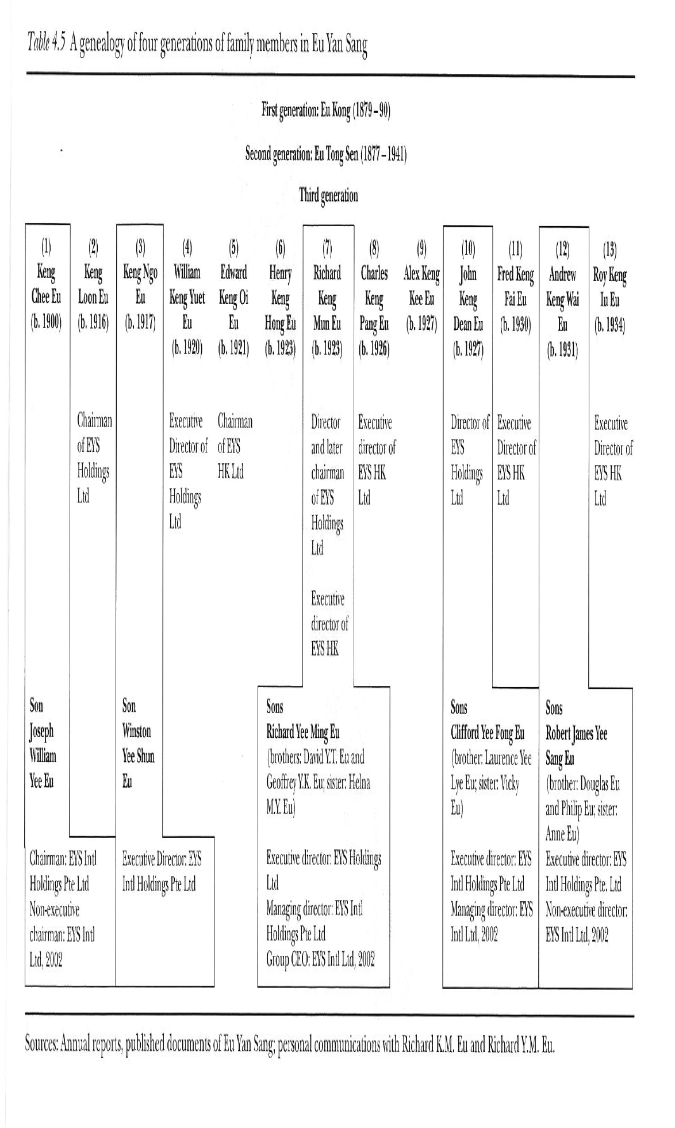
Henry Yeung W. C, Chinese capitalism in a global era : towards hybrid capitalism (London, Routledge, 2004) chapter 4

Slide 18
Case Study:Third Generation takes over
1955: Eu Yan Sang (Singapore) Ltd Co
1973 Singapore stock exchange listing (incorporates both S’pore & Malaysia)
Public listing
Issues of ‘Disintegration’
Family share:
Majority share of 75% in EUS Holdings
‘New mindset’
Professionalization in Third Generation

Slide 19
Case Study: Fourth Generation and its challenges
Fourth Generation: Richard Eu, 1988
Transformation from family firm to TNC
Family ownership and control
Corporate structure
Professional management
Challenges:
Take over bid by Lum Chang Group
1994, conflict over trademarks between HK (Charles) & Singapore (Richard) companies
Success of the cousins (4th generation)

Slide 20
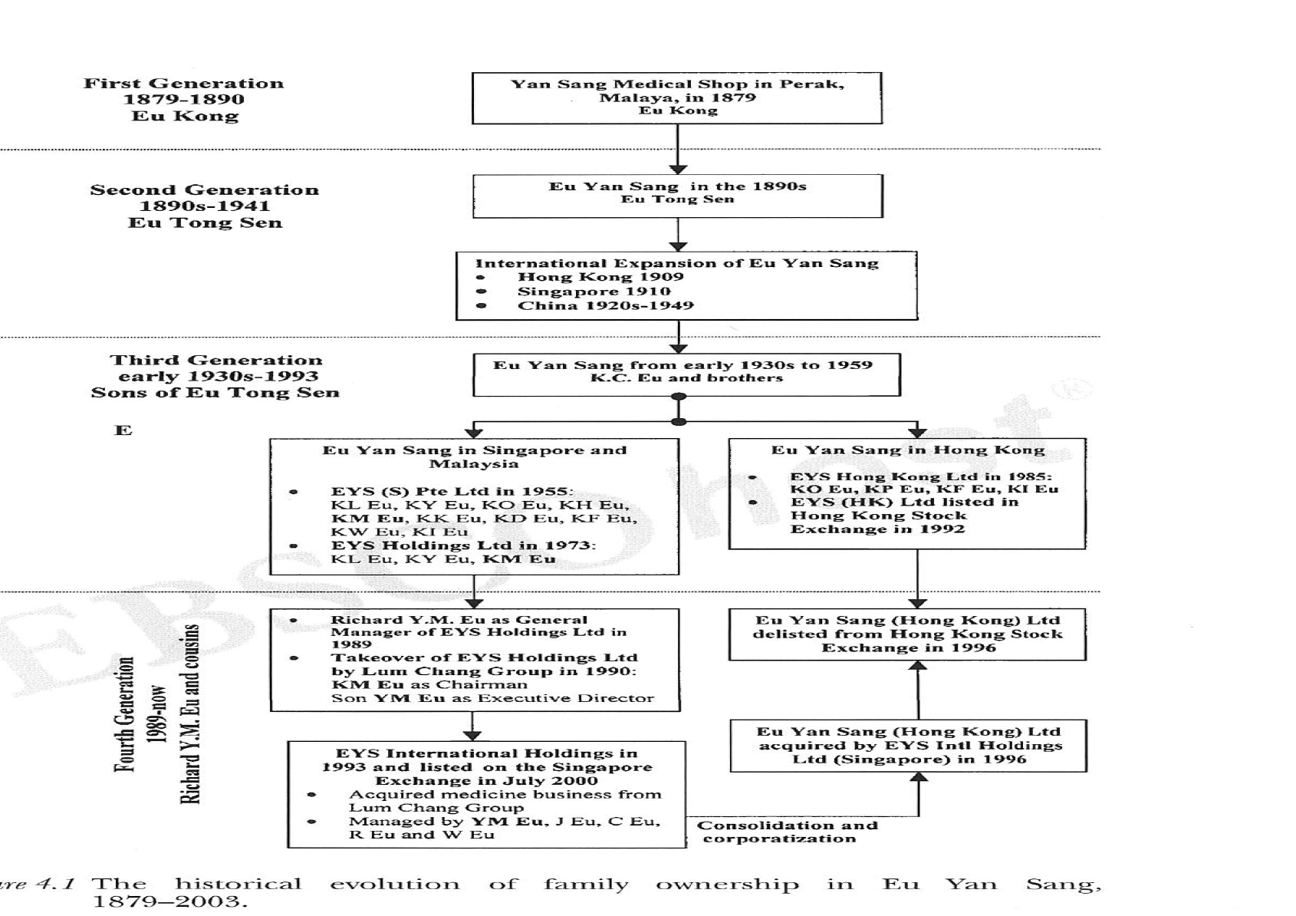
Henry Yeung W. C, Chinese capitalism in a global era : towards hybrid capitalism (London, Routledge, 2004) chapter 4

Slide 21
Case Study: Eu Yan Sang, 1876-
EYS: 230 retail outlets in Hong Kong, Macau, China, Malaysia, Singapore, and Australia,
Four factories in Hong Kong and Malaysia.
net profit 2014: S$15.03 million
TNC: revitalized

Slide 22
Challenges to family businesses
Succession planning
Leadership issues
Setting up structures
Professionalizing business
Strengthening corporate governance
Setting up structures, processes and systems

Slide 23
Additional Readings
Andrea Colli and Mary Rose, ‘Family Business,' Geoffrey Jones and J Zeitlin (ed), The Oxford Handbook of Business History (Oxford, 2007) pp. 194-218
Henry Yeung W. C, Chinese capitalism in a global era : towards hybrid capitalism (London, Routledge, 2004) Chapter 4

Slide 24
Thank you

